Slide 1
Mario Clone (Marino)
2D game (Platformer clone)

Slide 2
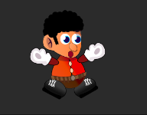
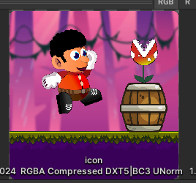
Used Materials and Assets
Player has been used for various actions using movement and animation :
Right
Left
Jump
Shoot
Fail
Features has been added into player object
Player also has been featured with needed lives (default 3)
Player has been download from assets

Slide 3
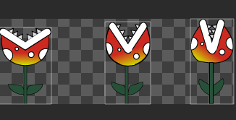
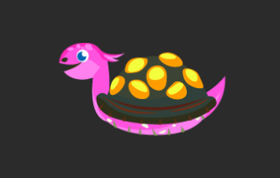
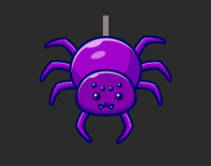
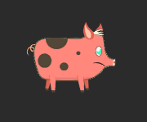
Used Materials and Assets
Various Enemies has been added into game logic
Danger Flower
Crazy Pig
Turtle
Spider
To all mentioned enemies damaging Player or killing feature has been applied
All objects has been set to needed part of game to make playing mode more interesting
Objects has been download from assets

Slide 4
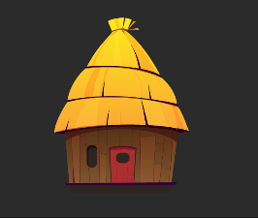
Used Materials and Assets
Target to reach needed mission has been implemented to each level of the game
Every level has been designed by logic to get needed target for player without loosing or failing
Everytime reaching next target player will be redirected to next level of the game
For target of all levels has been used same object as a house
Objects has been download from assets

Slide 5

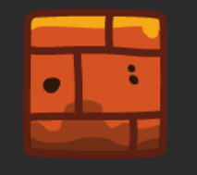
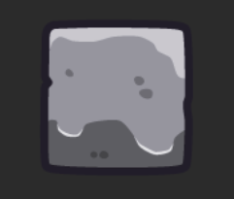
Used Materials and Assets
All levels of the game has been implemented using brick or ground based surface
Logic of the user play mode has been designed for jumping and moving forward
Surrounding of the player has been set as a floor of grounds to make play mode more dynamic and vibe
On each part of levels needed enemies and dangers has been added to surrounding
According to player and enemy color of the grounds has been selected

Slide 6
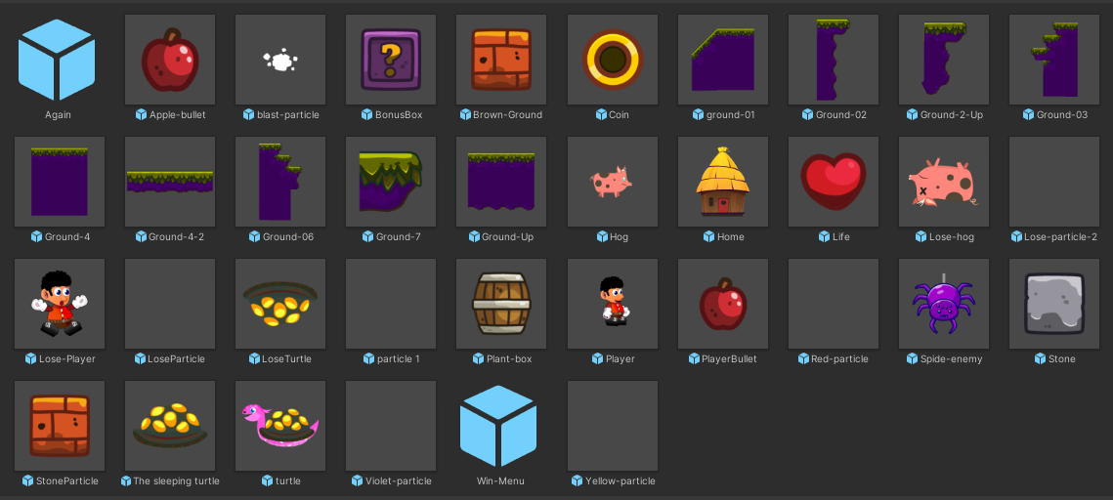
Additional Assets and Objects has been used

Slide 7
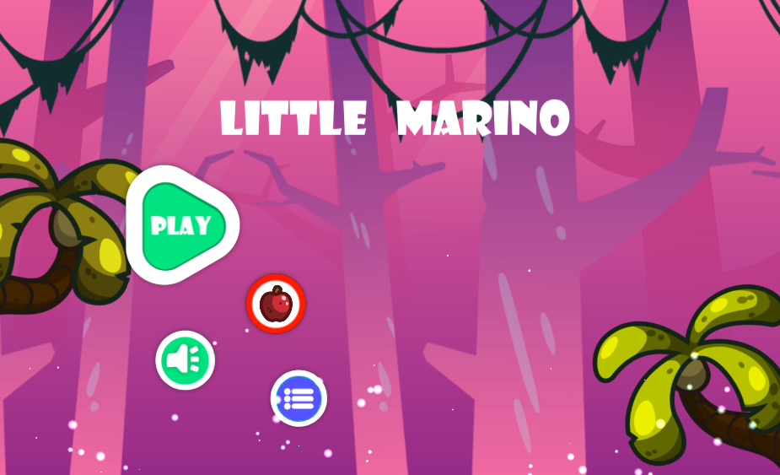
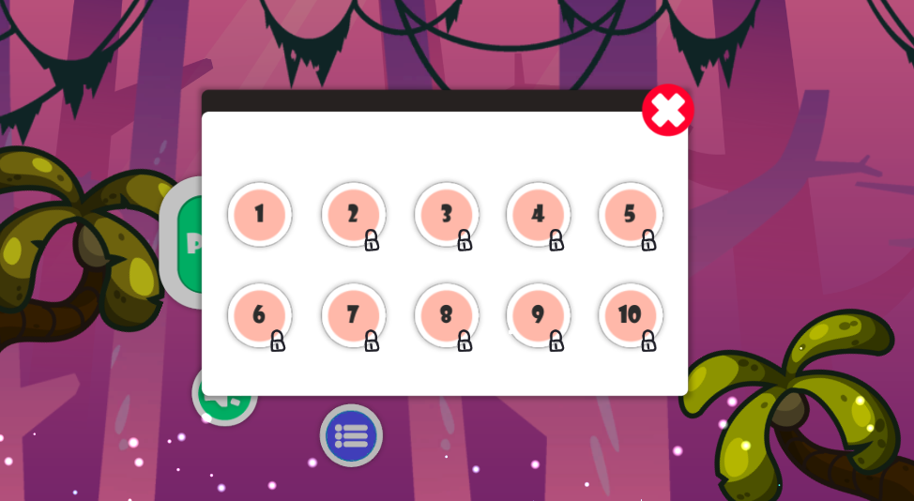
Main Menu and Level Selection part of the Game

Slide 8
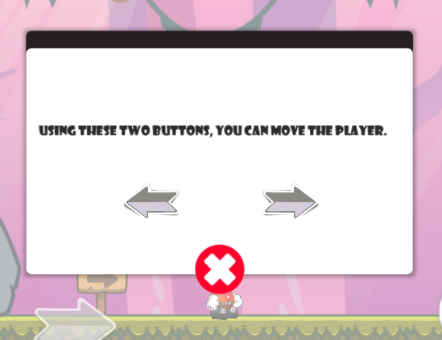
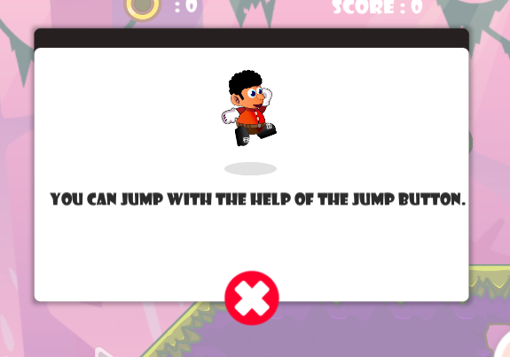
Extra explanation has been added for new players

Slide 9
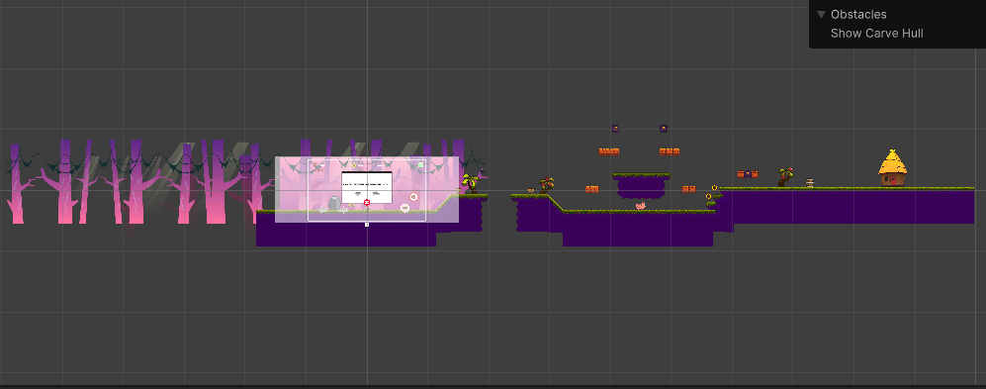
Simple level decoration and map of the game

Slide 10
List of completed tasks
Player Features has implemented (run, jump, kill, shoot, ect.)
Enemy logic has been implemented (kill, die, target and ect.)
Levels has been designed
Target and Level accomplishments has been developed
Live and shooting actions has been added
Main Menu has been developed
Explanation and note notifications has been added
Music and media control has been added

Slide 11
Get Game Project and Play movie
https://drive.google.com/file/d/1GQwMsbuNi9a0oh-YDKugjeBgAWfyye6h/view?usp=share_link

